Slide 1

SuperTux Software Architecture
Assignment 2: Concrete Architecture
CMPE 326
TA: Dayi Lin
Team: Pingu Simulator Date: November 10, 2017

Slide 2
Overview
Old Conceptual Architecture
Concrete Architecture
Reflexion Analysis
Sequence Diagram
Low-Level Subsystem
Proposed Feature
Lessons Learned

Slide 3
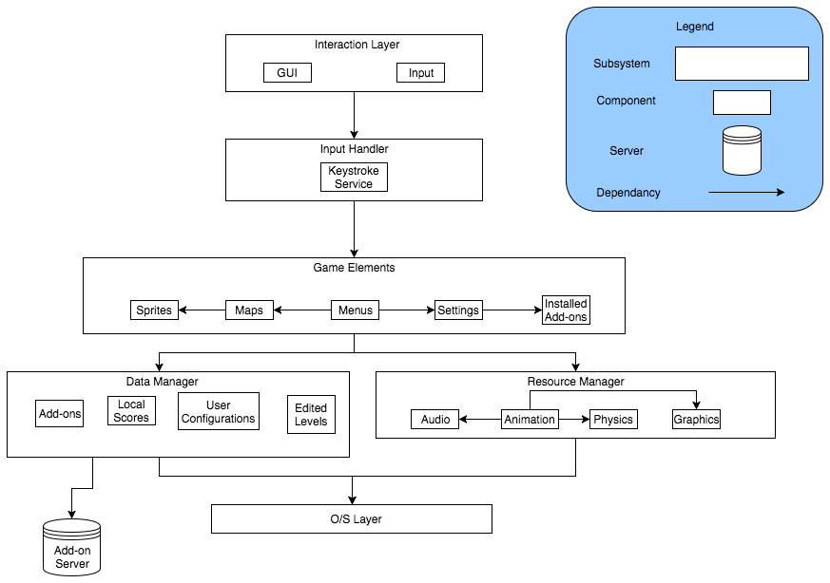
Old Conceptual Architecture

Slide 4
Derivation Process
Created a basic five level layered/object-oriented system
Interaction Layer, Input Handler, Resource Manager, Game Element, Add-on Manager
Derived our concrete architecture with the Understand tool
Tried to keep most files that were grouped together in the source code by the developers together within our layers.
Examine internal dependencies of each layer to see if our architecture diagram needed to be updated or if the file could be moved to a more sensible location
Concurrency
SuperTux is multi-threaded. While the game is running, some processes are executed concurrently
Audio and Graphics
Physics and Supertux

Slide 5
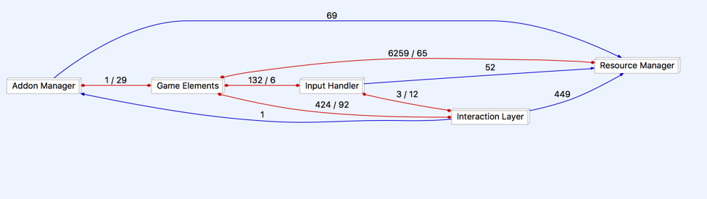
Understand Diagram

Slide 6
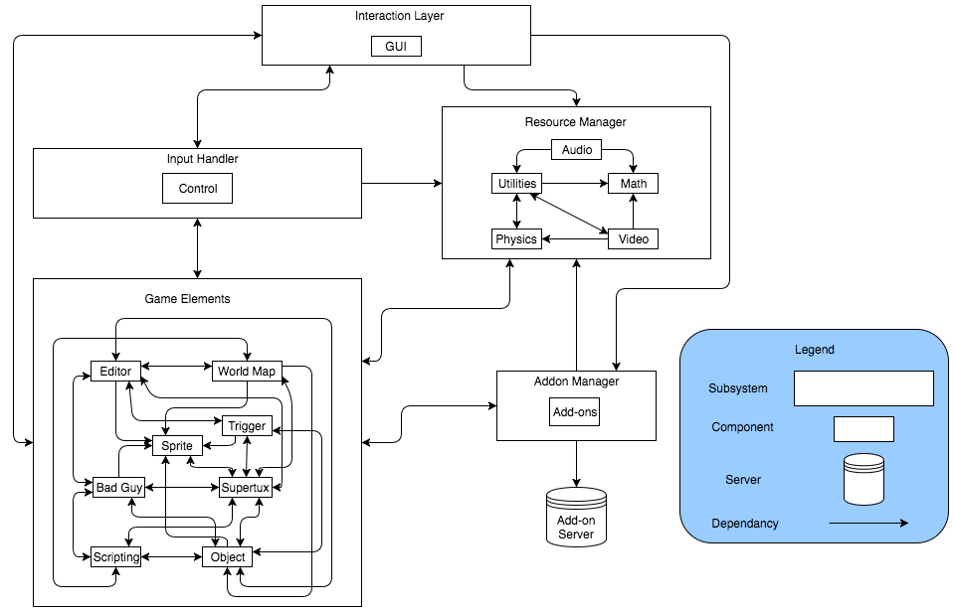
Concrete Architecture

Slide 7
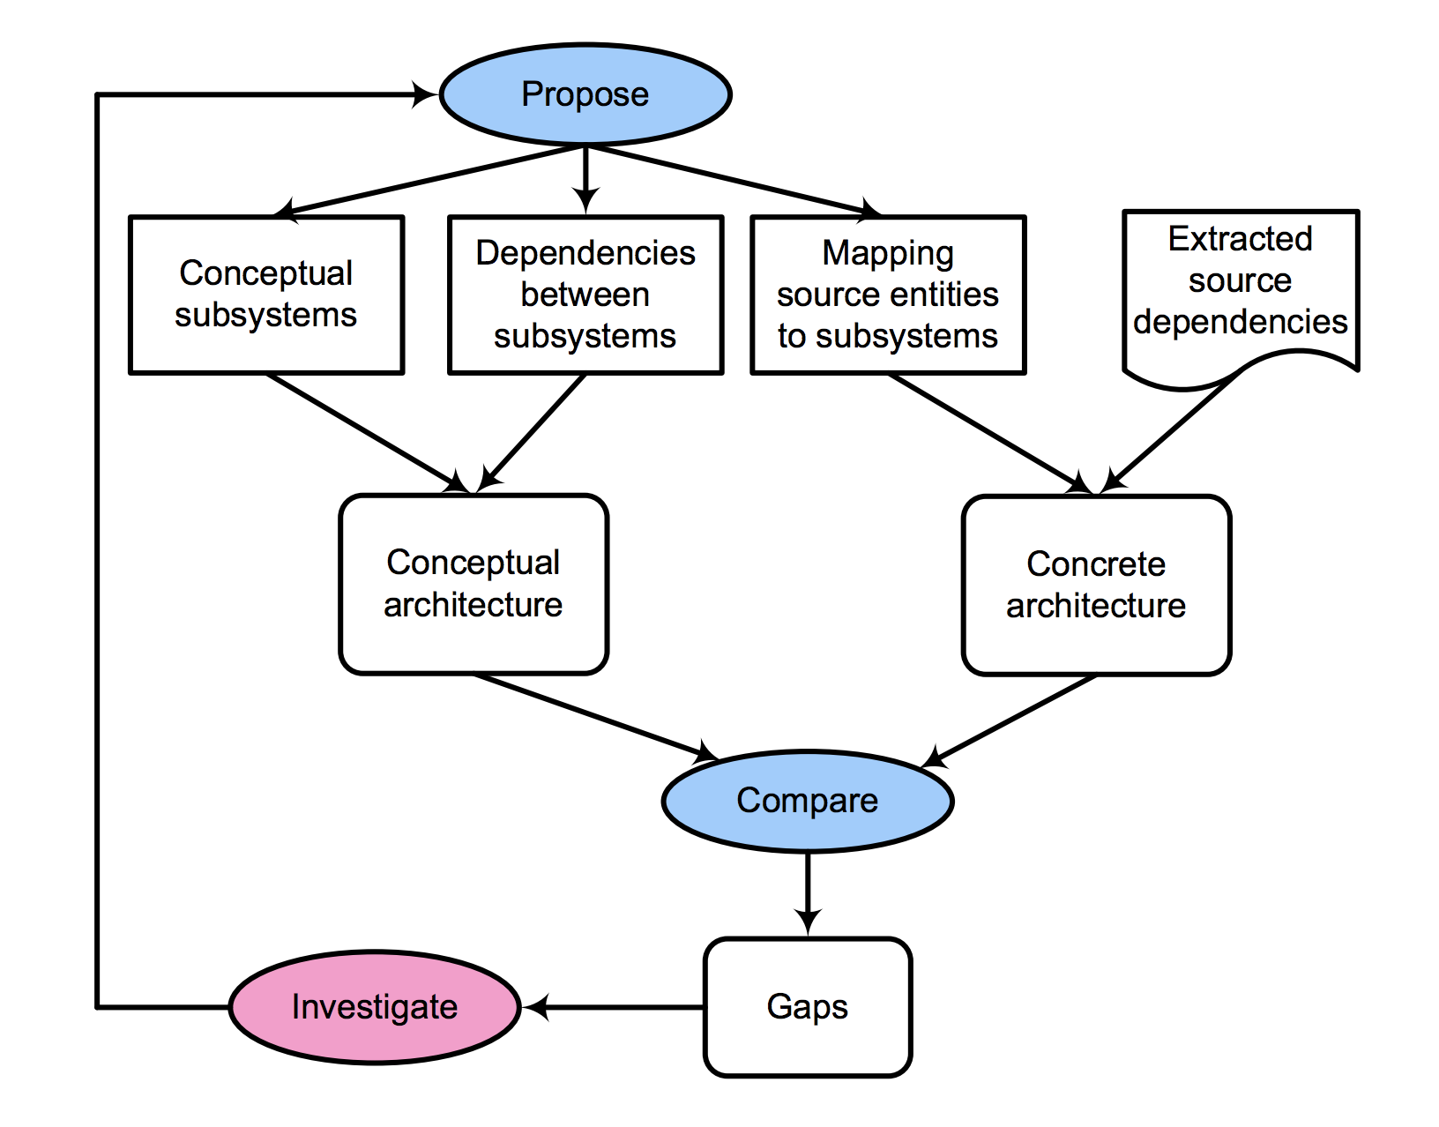
Reflexion Analysis

Slide 8
Unexpected Dependencies
Unexpected number of double sided dependencies, if it was truly a layered architecture there wouldn't be any
Resource Manager does not seem like it should depend on Game Elements
Scripting seems to be a place to add random functionality to components
We didn't think the Interaction Layer would depend on Game Elements
Game Elements should just send things to the GUI to be displayed but not the other way

Slide 9
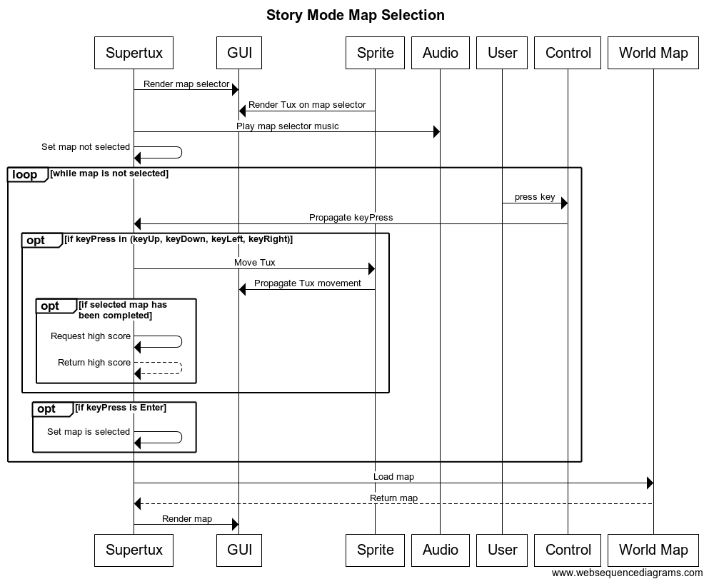
Sequence Diagram

Slide 10
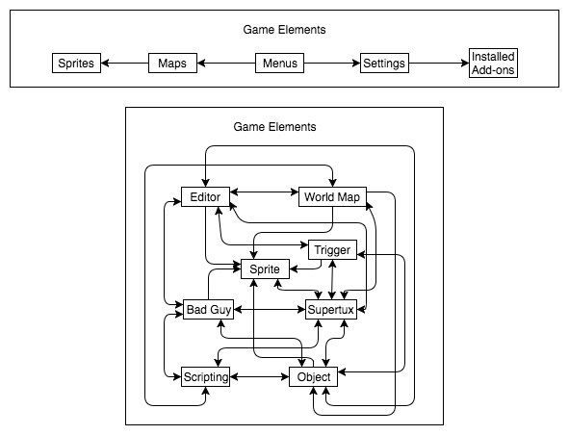
Low-Level Subsystem

Slide 11
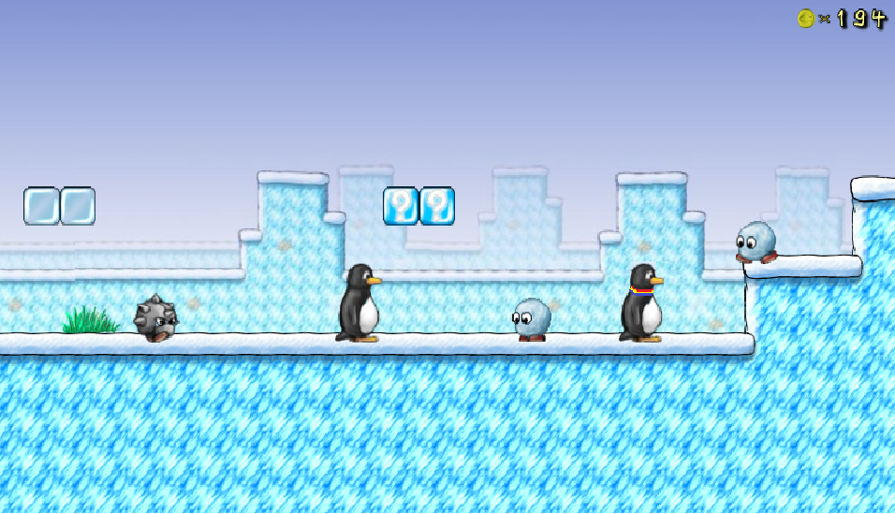
Proposed Feature - Multiplayer

Slide 12
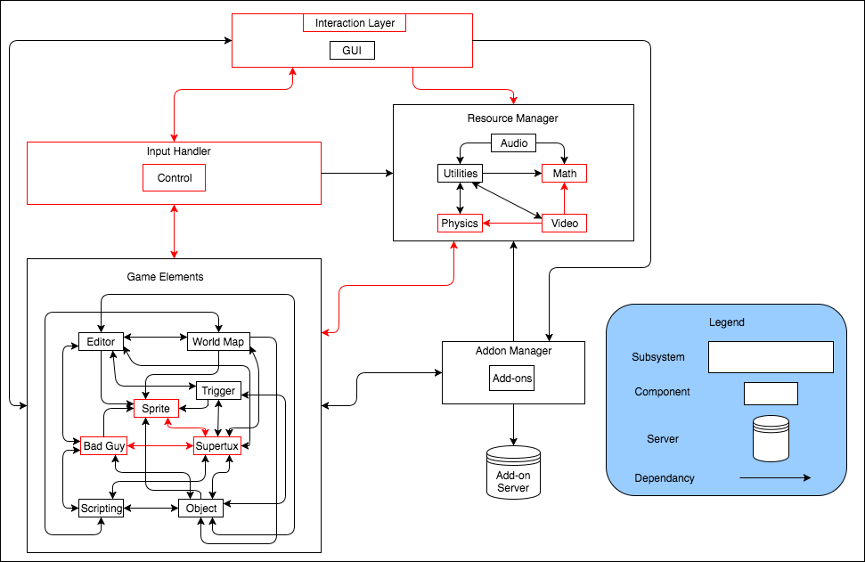
Proposed Feature - Multiplayer

Slide 13
Lessons Learned
Higher coupling than we would have expected
In practice, software design requires some compromises and planning
When working in large teams it is important to state the architecture beforehand
Understand is a useful tool to understand the code base with a steep learning curve
It is hard to derive an architecture by just observing how the game runs without looking at the source code

Slide 14
Closing Points
Conceptual and concrete architecture were different
Architecture style is layered/object-oriented
There were some unexpected dependencies
Coding shortcuts, special cases
Our proposed feature for assignment three is local multiplayer

Slide 15
Thank You!

